Slide 1
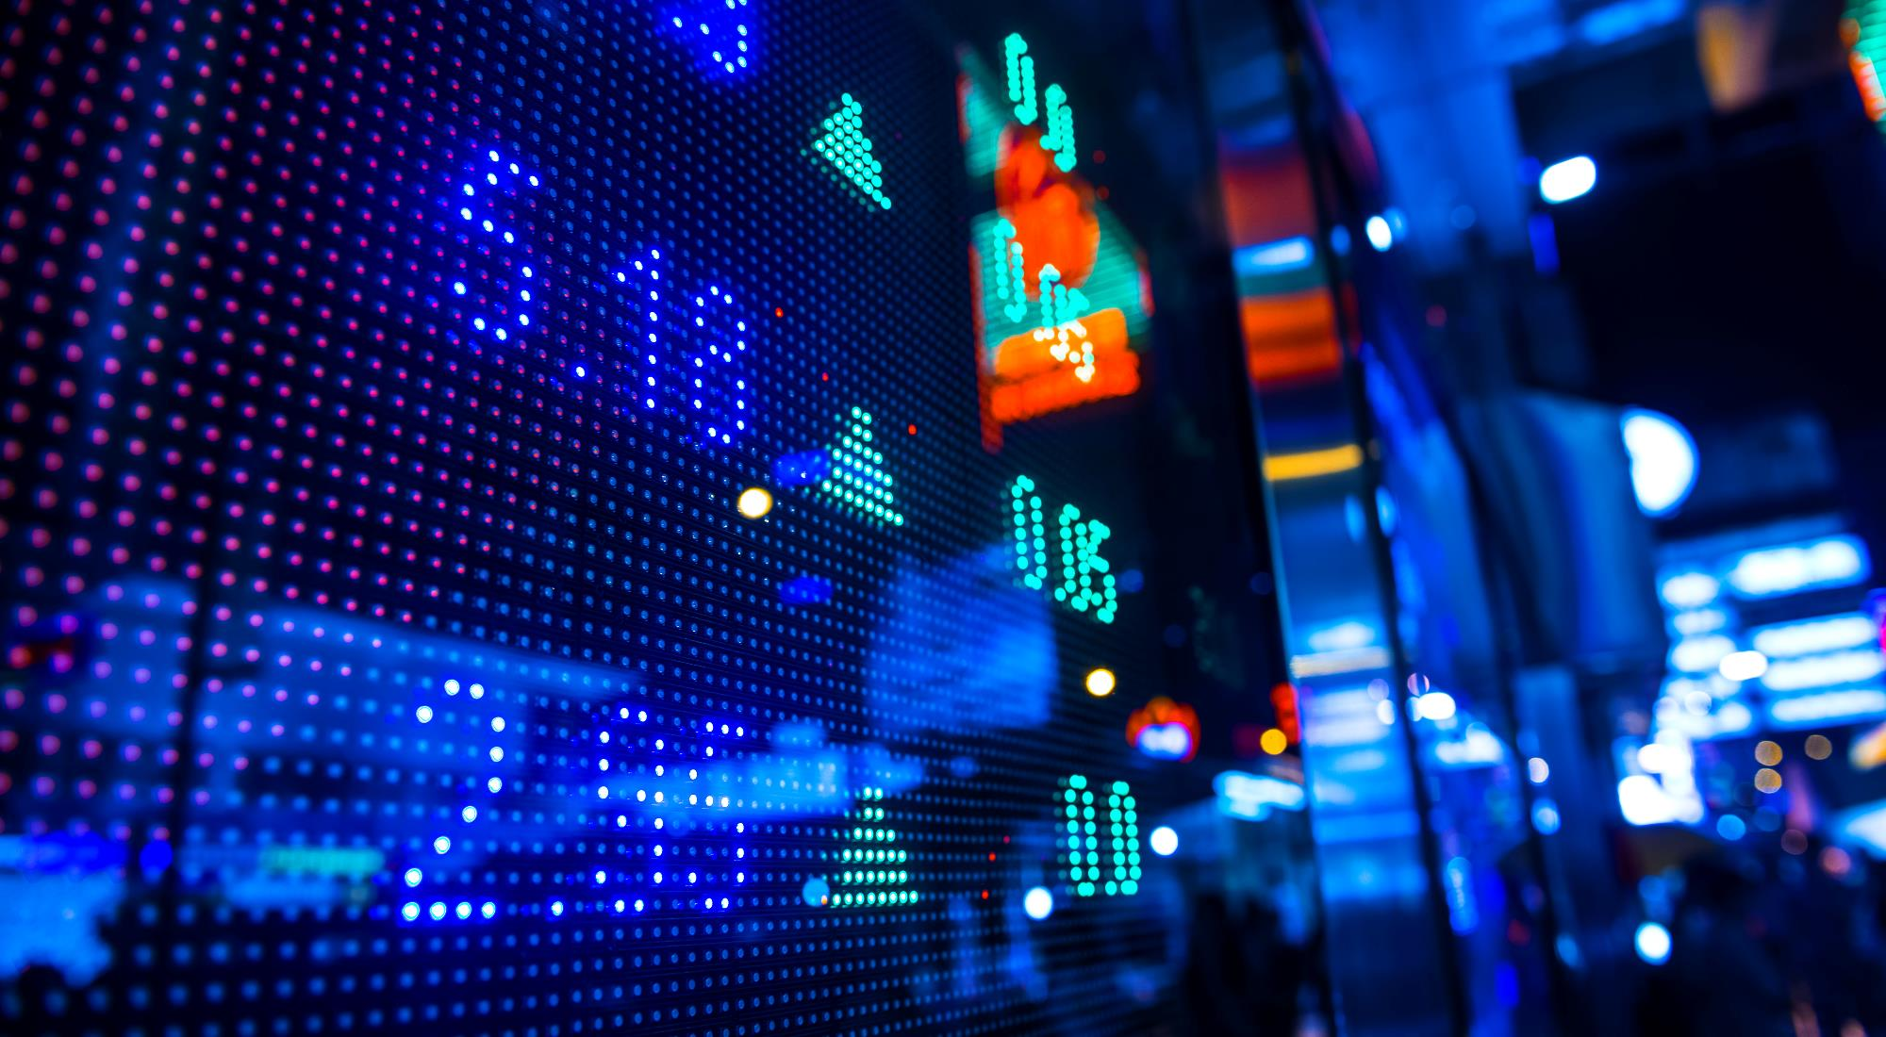
Developer connect
FIND YOUR PEER DEVELOPERS ANYWHERE ANYTIME.

Slide 2
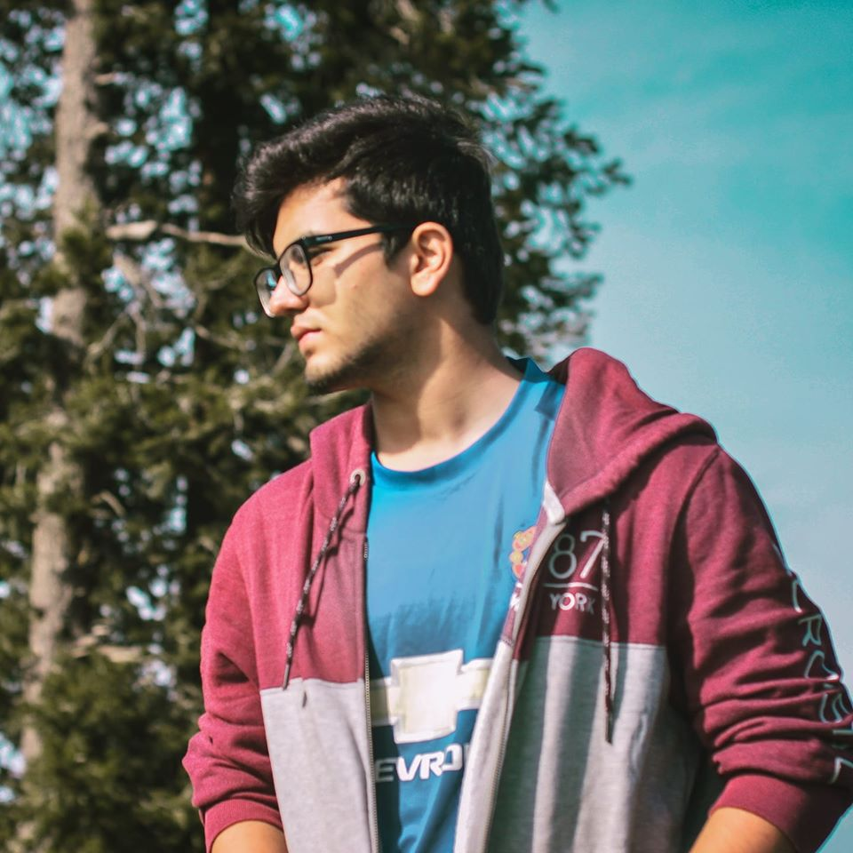
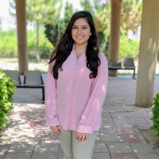
Team
Muhammad Hannan
Sabayna Ali

Slide 3
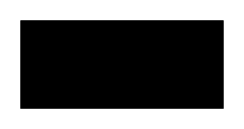




The Problem
Declining interaction
Financial
Trust
FOCUS
Most developers prefer not to interact with people and work behind the screen
Having to pay a lot much to international companies for little problems
Limited to NUSTIANS, thus trust is ensured
Unable to focus on coding and development on other platforms such as Facebook and Instagram

Slide 4
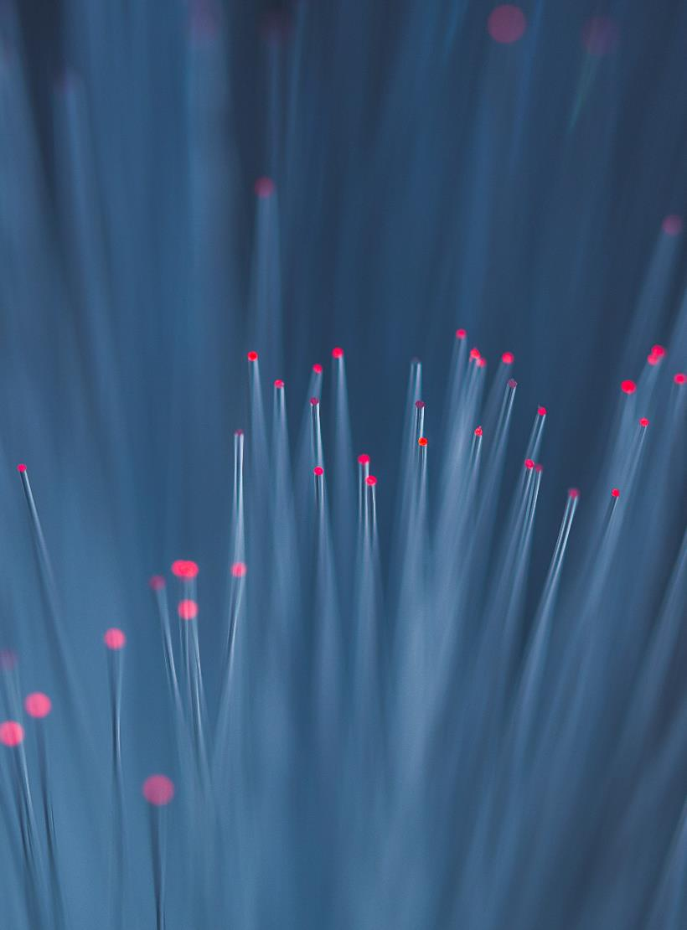


Solution
Prioritize
Create
Stay Updated
NUSTIANS DEVELOPERS ARE SHOW CASED
Problems solved remotely.New ideas generated
Live updates for TIC, NSTP. Never feel left behind
Bringing all nustian developers at one place.

Slide 5
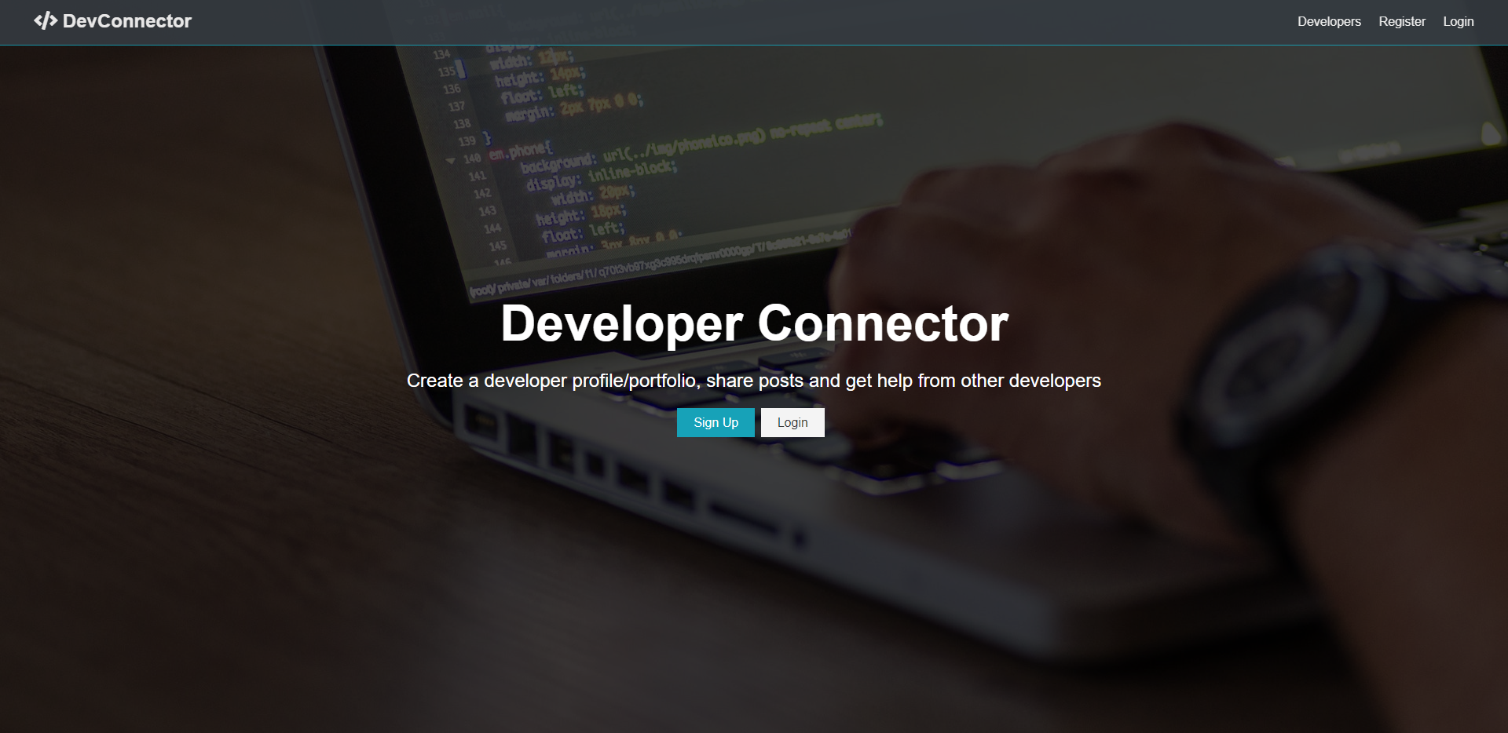

Slide 6
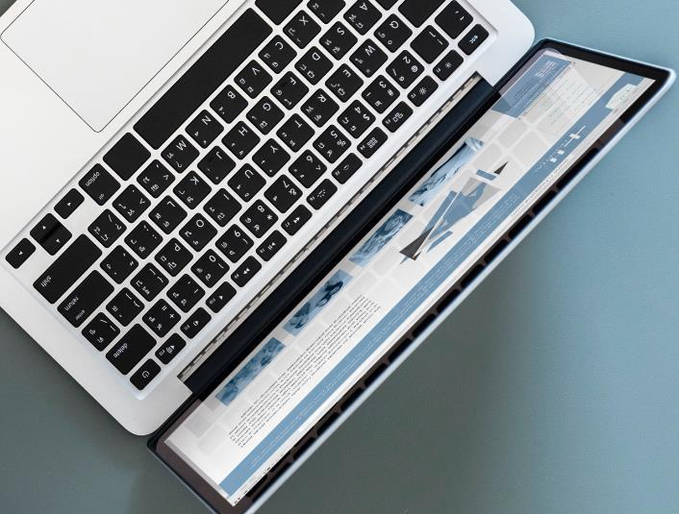
features
Create user profiles
Authentication
Create posts
Add comments
Visit profiles

Slide 7

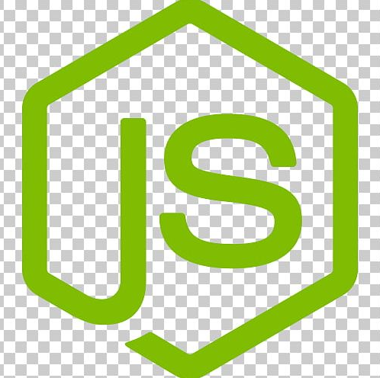

Technologies used
The website was built using the MERN STACK
Mongo DB
Node and Express
React
Storing the user profiles, posts, and updates
The server side and entire backend implementation
Creating the front end of the website

Slide 8
Development Process
How will we scale in the future
Phase 1 Creating the front end React
Phase 2 Back end using express and mongo dB
Phase 3 Integrating Node with express and mongo

Slide 9
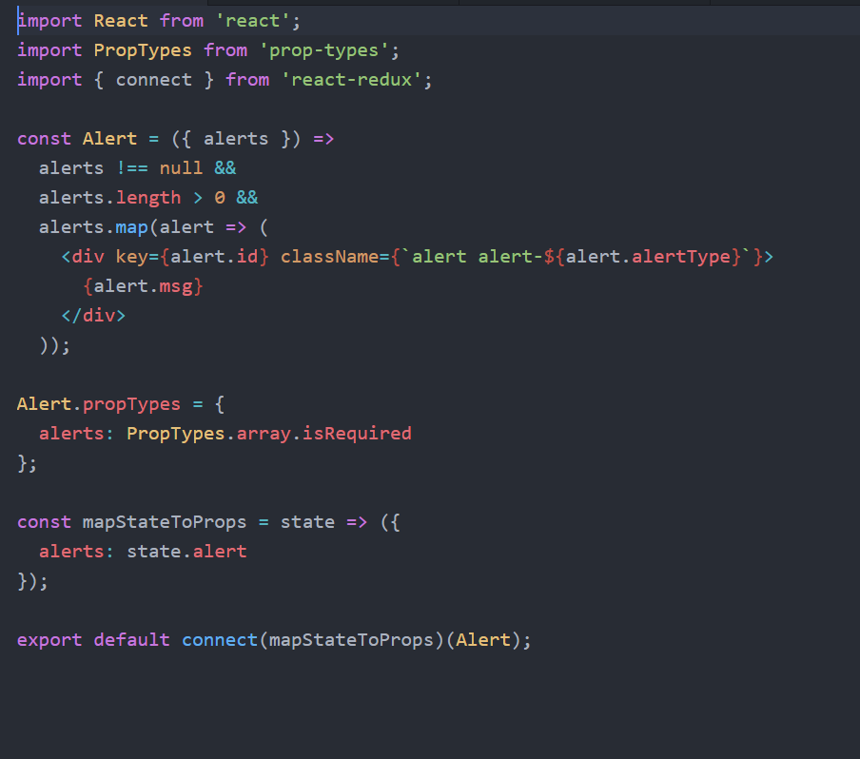
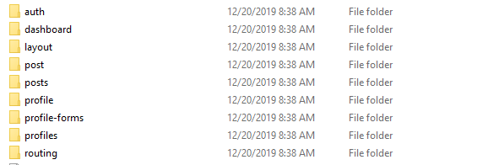
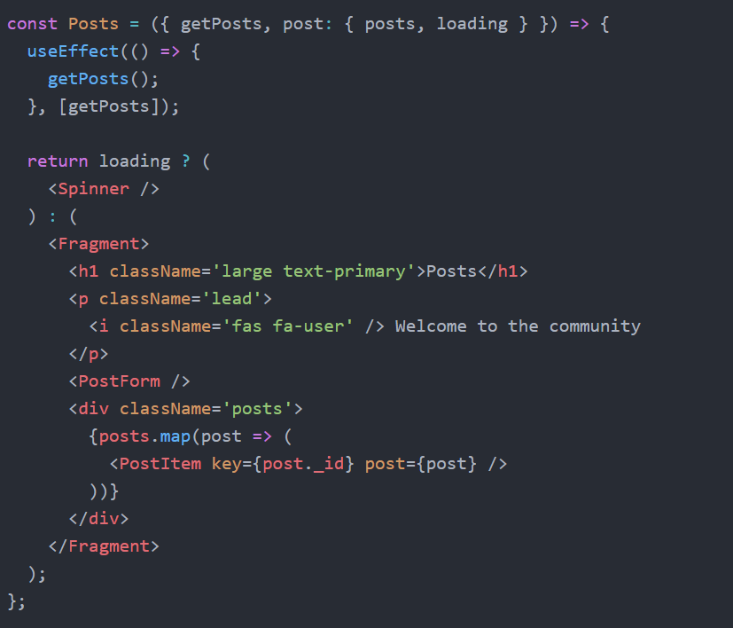
Creating the front end
React (declarative approach)
COMPONENTS:

Slide 10
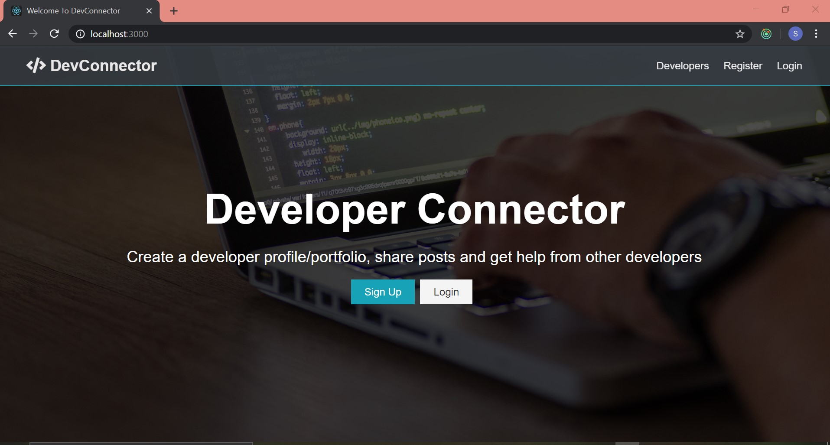
CONT.

Slide 11
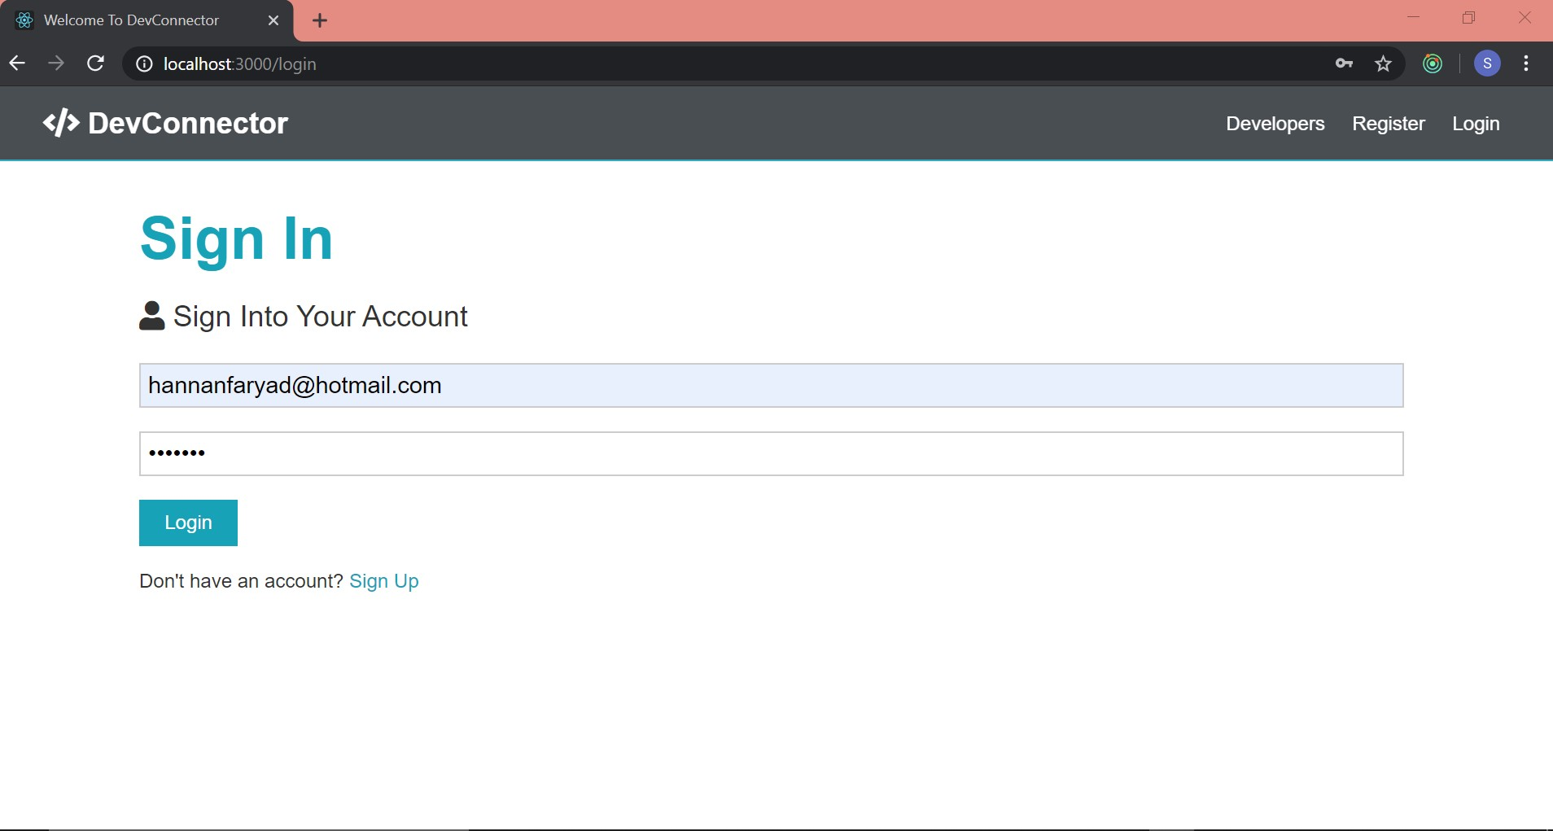
CONT.

Slide 12
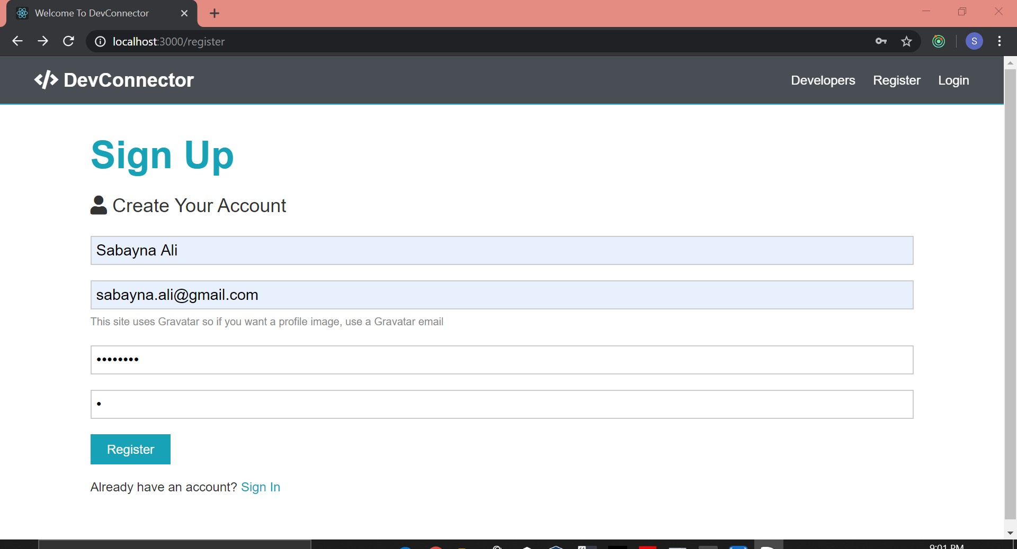
CONT.

Slide 13
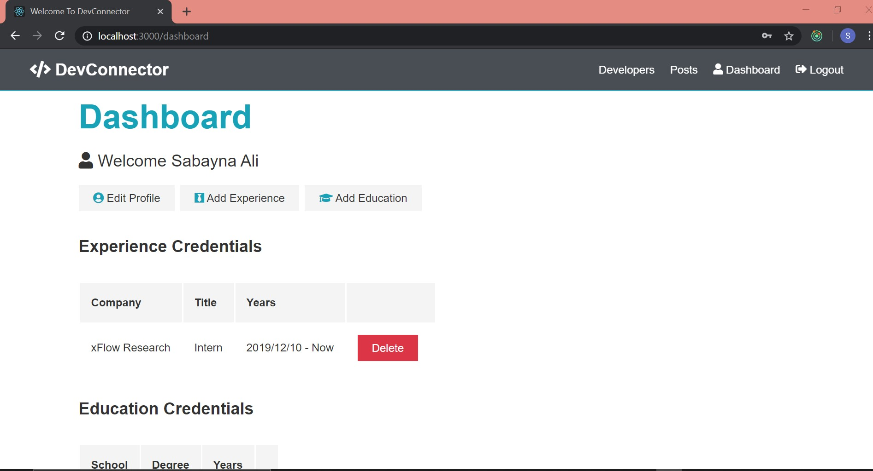
CONT.

Slide 14
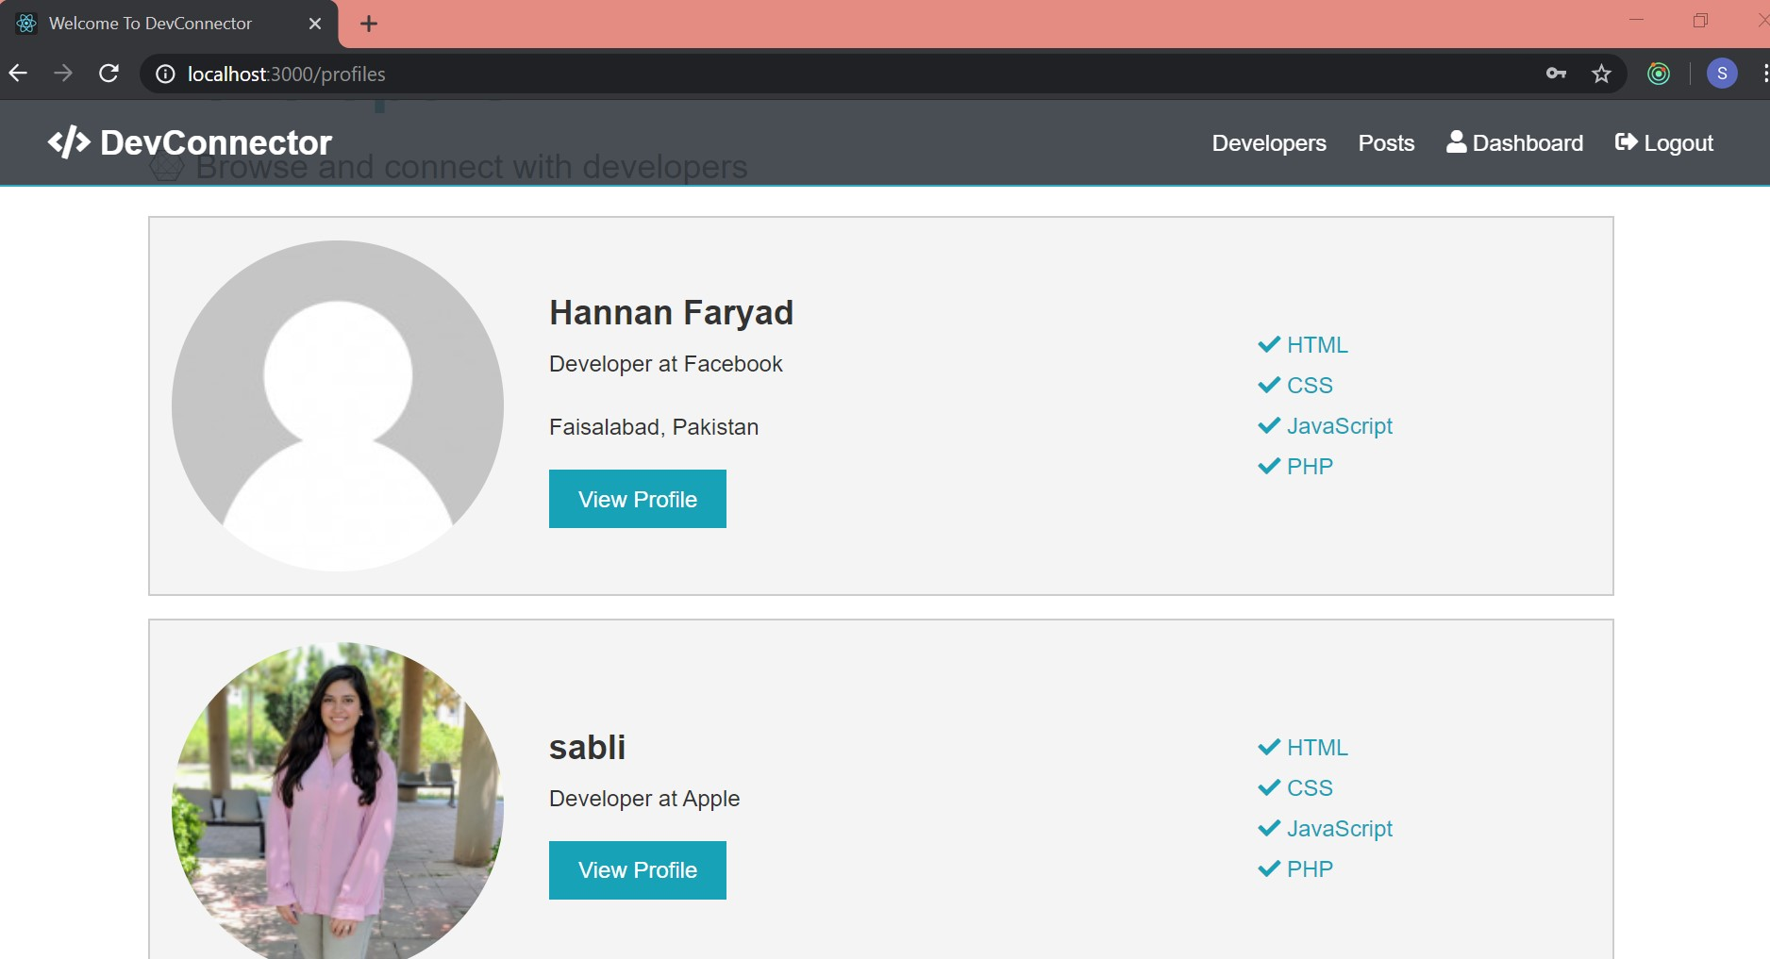
CONT.

Slide 15
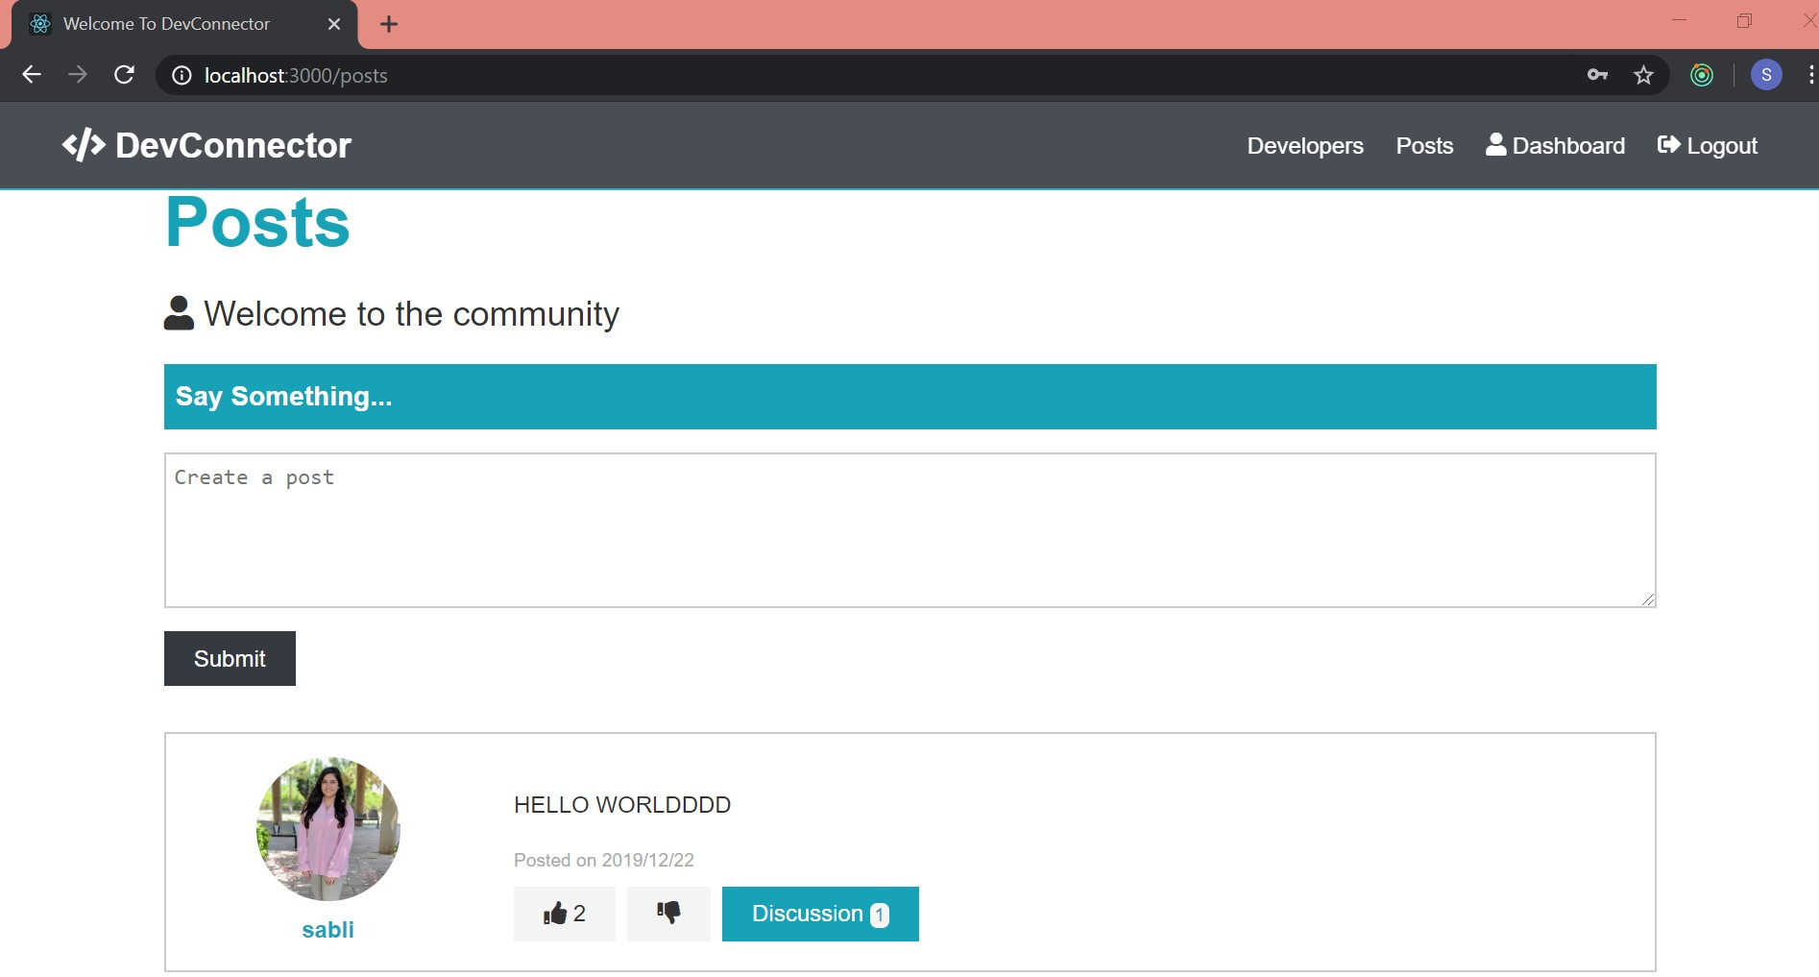
CONT.

Slide 16
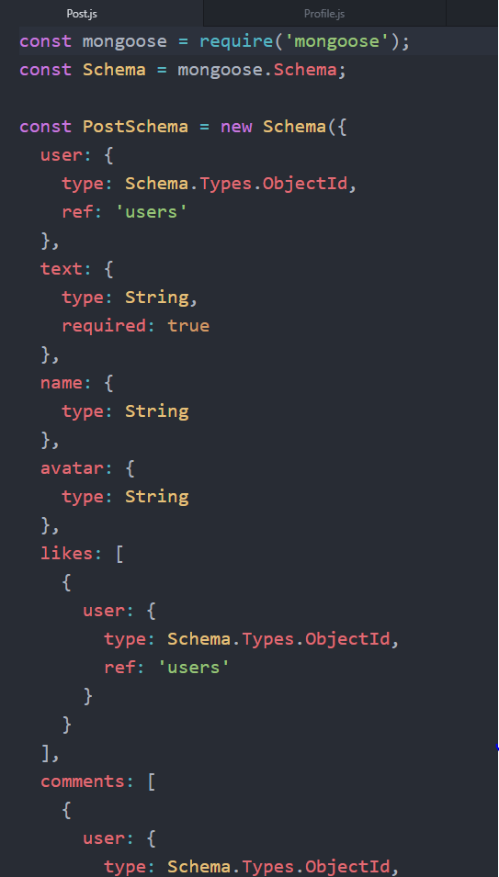
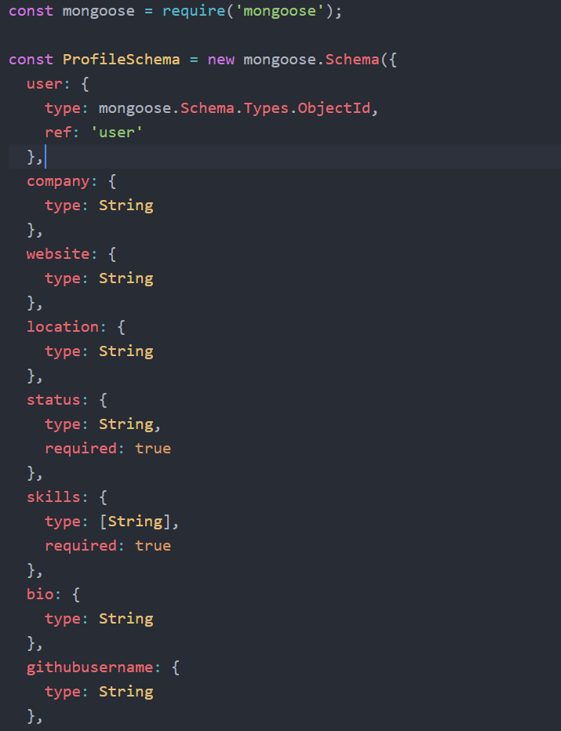
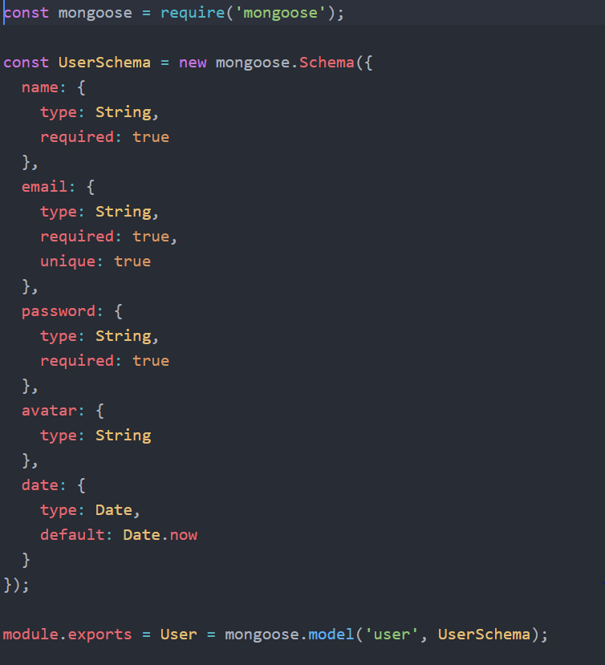
BACK END

Slide 17
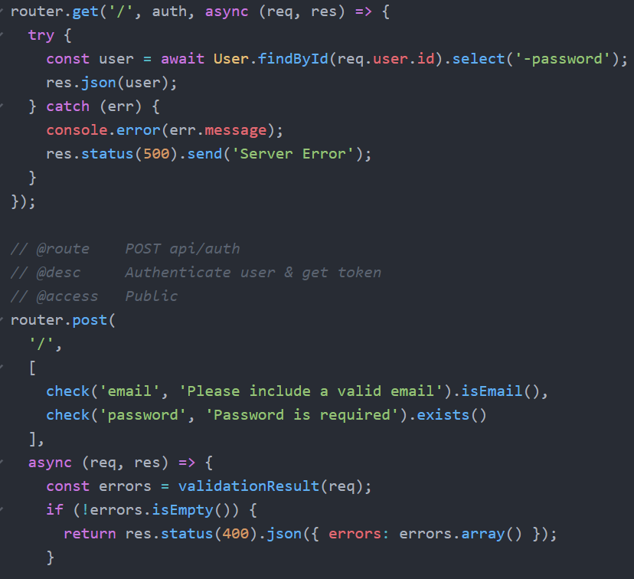
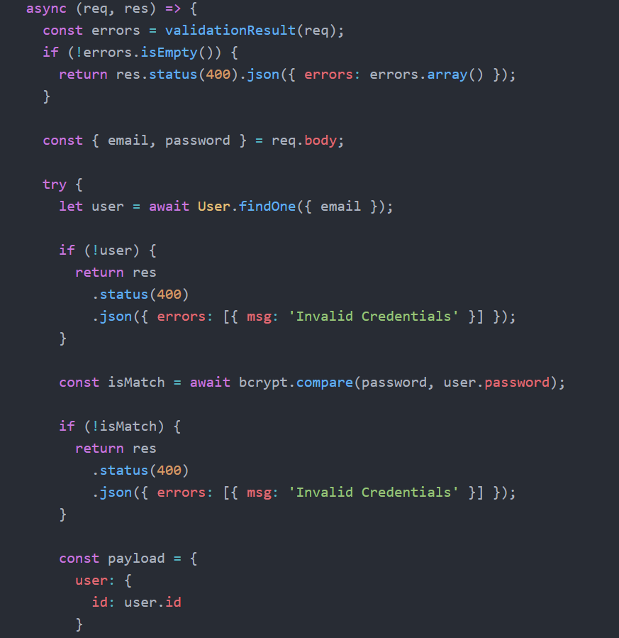
Authentication

Slide 18
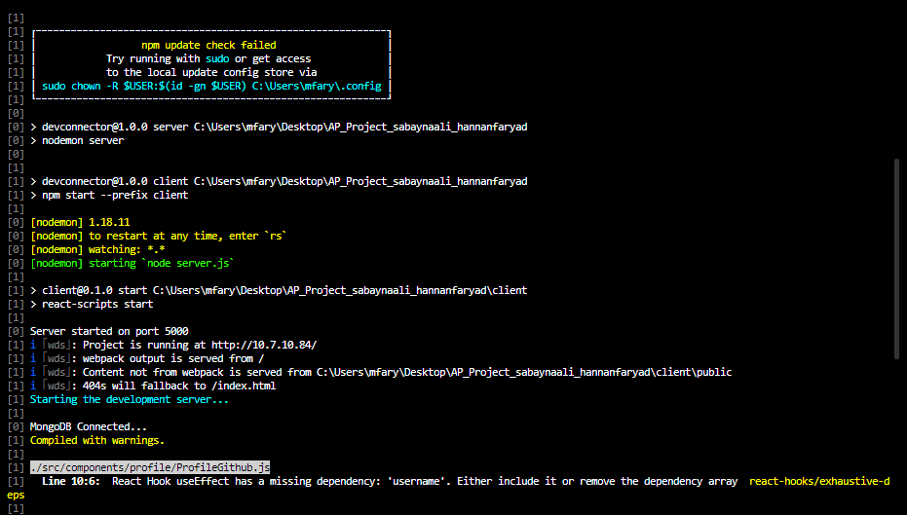
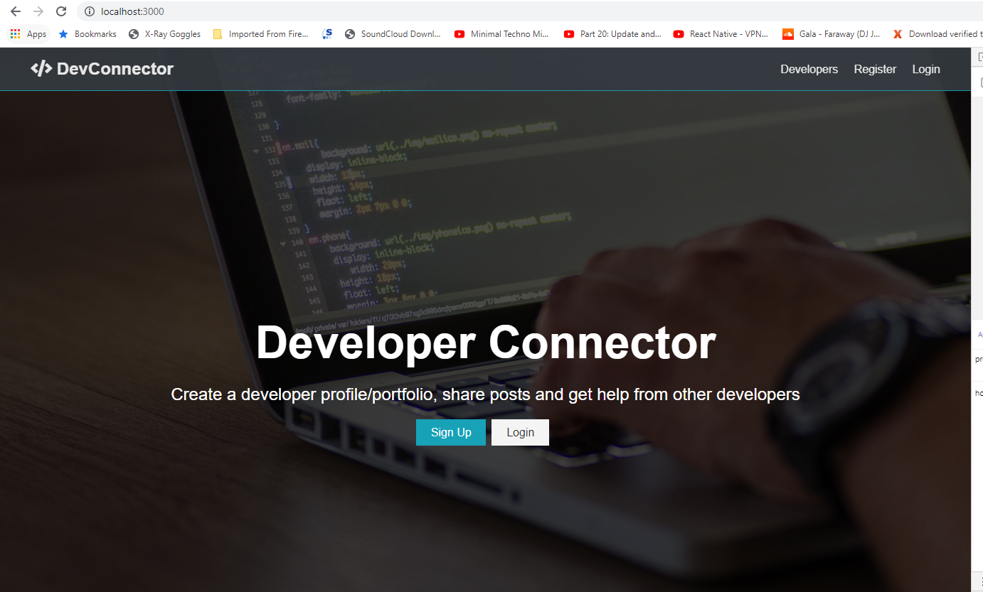
RUNNING

Slide 19

Thank You

